Slide 1
Murach’s ASP.NET Core MVC (2nd Ed.)
Chapter 11
How to validate data

Slide 2
Objectives (part 1)
Applied
Given the data validation requirements for a web form, use any of the validation techniques presented in this chapter to implement that validation.
Knowledge
Describe the default data validation provided by model binding.
Describe the use of attributes for data validation.
List six data validation attributes.
Describe the use of tag helpers for data validation.
Describe the use of the IsValid property of a controller’s ModelState property.
Describe the use of CSS to format validation messages.

Slide 3
Objectives (part 2)
Describe the use of a controller’s ModelState property for checking the validation state of a control and setting a custom error message.
Describe the use of model-level and property-level validation messages.
Describe the use of unobtrusive client-side data validation.
Distinguish between client-side validation and server-side validation.
Describe the process of customizing server-side data validation.
Describe the process of implementing remote validation.
Describe the process of customizing client-side data validation.

Slide 4
The Movie class
public class Movie
{
public string Name { get; set; } = string.Empty;
public int Rating { get; set; }
}

Slide 5
A strongly-typed view that posts a Movie object to an action method (part 1)
@model Movie
...
<div asp-validation-summary="All" class="text-danger">
</div>
<form asp-action="Add" method="post">
<div class="row">
<div class="col-1">
<label asp-for="Name" class="form-label">
Name:</label>
</div>
<div class="col-4">
<input asp-for="Name" class="form-control" />
</div>
<div class="col-2">
<label asp-for="Rating" class="form-label">
Rating (1-5):</label>
</div>

Slide 6
A strongly-typed view that posts a Movie object to an action method (part 2)
<div class="col-2">
<input asp-for="Rating" class="form-control"
type="text" />
</div>
<div class="col">
<button type="submit"
class="btn btn-primary">
Submit
</button>
</div>
</div>
</form>

Slide 7
An action method that receives a Movie object from the view
[HttpPost]
public IActionResult Add(Movie movie)
{
if (ModelState.IsValid) {
// code that adds movie to database
return RedirectToAction("List");
}
else {
return View(movie);
}
}

Slide 8
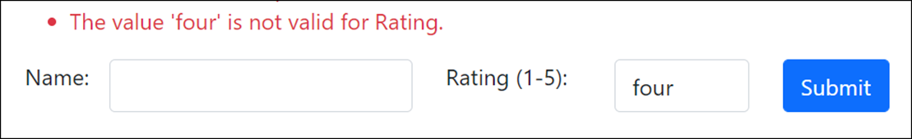
How it looks in the browser when the rating can’t be cast to an int

Slide 9
Common data attributes for validation
Required
Range(min, max)
Range(type, min, max)
StringLength(length)
RegularExpression(ex)
Compare(other)
Display(Name = "n")

Slide 10
The Movie entity class with data attributes
using System.ComponentModel.DataAnnotations;
...
public class Movie
{
[Required]
[StringLength(30)]
public string Name { get; set; }
[Range(1, 5)]
public int Rating { get; set; }
}

Slide 11
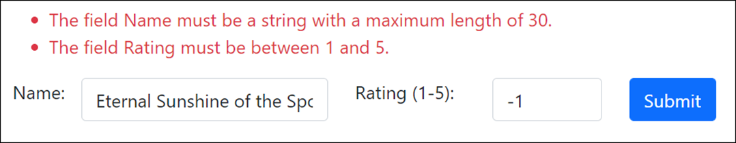
The view after the user submits invalid data

Slide 12
The default validation messages
Attribute | Message
Required | The field [Name] is required.
Range | The field [Name] must be between [minimum] and [maximum].
StringLength | The field [Name] must be a string with a maximum length of [length].
RegularExpression | The field [Name] must match the regular expression '[pattern]'.
Compare | '[Name]' and '[OtherName]' do not match.

Slide 13
How to replace the default message with a custom message
[Required(ErrorMessage = "Please enter a name")]
[StringLength(30,
ErrorMessage = "Name must be 30 characters or less.")]
public string Name { get; set; }
[Range(1, 5,
ErrorMessage = "Please enter a rating between 1 and 5.")]
public int Rating { get; set; }

Slide 14
The Customer class
public class Customer {
[Required(ErrorMessage = "Please enter a username.")]
[RegularExpression("^[a-zA-Z0-9]+$",
ErrorMessage = "Username may not contain special characters.")]
public string Username { get; set; } = string.Empty;
[Required(ErrorMessage = "Please enter a date of birth.")]
[Range(typeof(DateTime), "1/1/1900", "12/31/9999",
ErrorMessage = "Date of birth must be after 1/1/1900.")]
public DateTime? DOB { get; set; }
[Required(ErrorMessage = "Please enter a password.")]
[StringLength(25)]
[Compare("ConfirmPassword")]
public string Password { get; set; } = string.Empty;
[Required(ErrorMessage = "Please confirm your password.")]
[Display(Name = "Confirm Password")]
public string ConfirmPassword { get; set; } = string.Empty;
}

Slide 15
A validation tag in a strongly-typed view that posts a Customer object
<div asp-validation-summary="All" class="text-danger">
</div>
<input asp-for="Username" class="form-control" />
<input asp-for="DOB" class="form-control" type="text" />
<input asp-for="Password" class="form-control"
type="password" />
<input asp-for="ConfirmPassword" class="form-control"
type="password" />

Slide 16
An action method that receives a Customer object from the view
public IActionResult Add(Customer customer) {
if (ModelState.IsValid) {
// code that adds customer to database
return RedirectToAction("Welcome");
} else {
return View(customer);
}
}

Slide 17
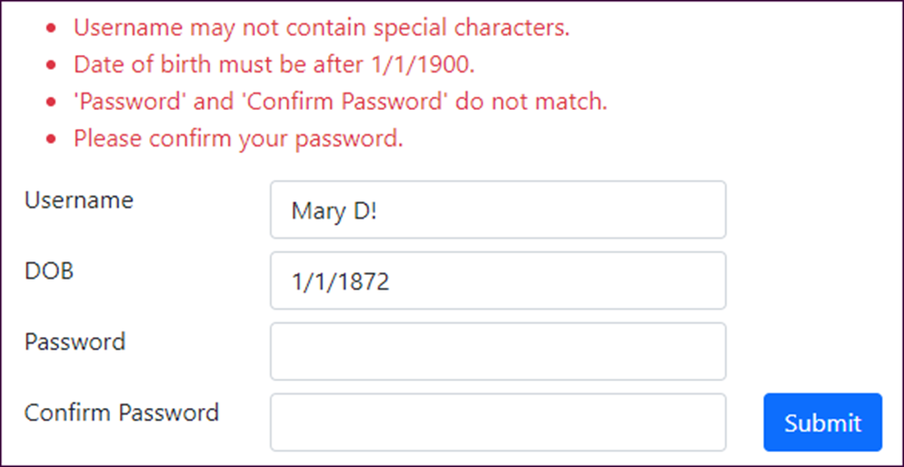
The Registration page after the user submits invalid data

Slide 18
The HTML that MVC emits for an <input> tag bound to the Username property
<input class="form-control" type="text"
data-val="true"
data-val-regex="User name may not contain special characters."
data-val-regex-pattern="^[a-zA-Z0-9]&#x2B;$"
data-val-required="Please enter a user name."
id="Username" name="Username" value="" />
The HTML that MVC emits for the <input> tag when data validation fails
<input class="form-control input-validation-error" type="text"
data-val="true"
data-val-regex="User name may not contain special characters."
data-val-regex-pattern="^[a-zA-Z0-9]&#x2B;$"
data-val-required="Please enter a user name."
id="Username" name="Username" value="" />

Slide 19
The HTML emited for a summary of valid data
<div class="text-danger validation-summary-valid"
data-valmsg-summary="true">
<ul><li style="display:none"></li></ul>
</div>
The HTML emitted for a summary of invalid data
<div class="text-danger validation-summary-errors"
data-valmsg-summary="true">
<ul>
<li>Please enter a user name.</li>
<li>Please enter a date of birth.</li>
</ul>
</div>

Slide 20
Some CSS styles in the site.css file
.input-validation-error {
border: 2px solid #dc3545; /* same red as text-danger */
background-color: #faebd7; /* antique white */
}
.validation-summary-valid { display: none; }
.validation-summary-errors ul { list-style: none; }

Slide 21
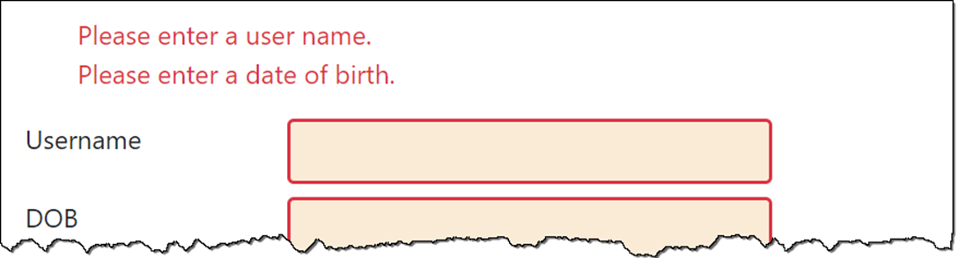
The view with formatted validation

Slide 22
Properties of the ModelStateDictionary class
Count
ErrorCount
IsValid
Keys
Values
Methods of the ModelStateDictionary class
AddModelError(key, msg)
GetValidationState(key)

Slide 23
Code that adds a validation message to the ModelState property
using Microsoft.AspNetCore.Mvc.ModelBinding;
...
[HttpPost]
public IActionResult Add(Customer customer)
{
string key = nameof(Customer.DOB);
if (ModelState.GetValidationState(key) ==
ModelValidationState.Valid) {
if (customer.DOB > DateTime.Today) {
ModelState.AddModelError(
key, "Date of birth must not be a future date.");
}
}
if (ModelState.IsValid) {
// code that adds customer to database
return RedirectToAction("Welcome");
}
else {
return View(customer);
}
}

Slide 24
Two tag helpers used with data validation
asp-validation-summary
asp-validation-for
The values of the ValidateSummary enum
All
ModelOnly
None

Slide 25
An action method that adds a model-level validation message
[HttpPost]
public IActionResult Add(Customer customer) {
if (ModelState.IsValid) {
// code that adds customer to database
return RedirectToAction("Welcome");
} else {
ModelState.AddModelError("",
"There are errors in the form.");
return View(customer);
}
}

Slide 26
Part of a view that displays both model-level and property-level messages
<div asp-validation-summary="ModelOnly"
class="text-danger"></div>
<form asp-action="Add" method="post">
<div class="row mb-2">
<div class="col-md-2">
<label asp-for="Username" class="form-label">
</label>
</div>
<div class="col-md-4">
<input asp-for="Username"
class="form-control" />
</div>
<div class="col-md-6">
<span asp-validation-for="Userame"
class="text-danger"></span>
</div>
</div>
...

Slide 27
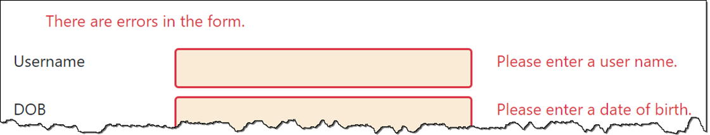
The form in the browser after validation fails

Slide 28
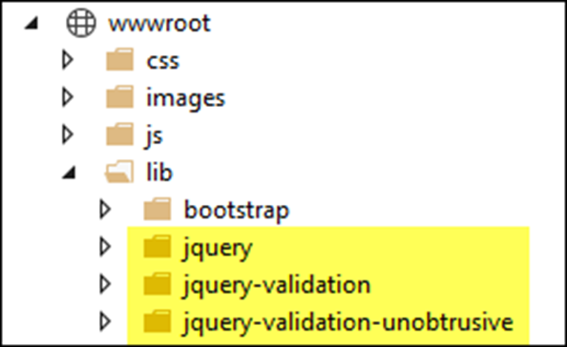
The jQuery libraries that download by default with the MVC template

Slide 29
The jQuery libraries in a Layout view
<head>
<meta name="viewport" content="width=device-width" />
<link href="~/lib/bootstrap/dist/css/bootstrap.min.css"
rel="stylesheet" />
<link href="~/css/site.css" rel="stylesheet" />
<script src="~/lib/jquery/dist/jquery.min.js"></script>
<script src="~/lib/jquery-validation/dist/
jquery.validate.min.js">
</script>
<script src="~/lib/jquery-validation-unobtrusive/
jquery.validate.unobtrusive.min.js">
</script>
<title>@ViewBag.Title</title>
</head>

Slide 30
Some caveats to client-side validation
It only works correctly with property-level validation, not model-level validation.
Any server-side validation doesn’t run until all client-side validation passes. This can lead to a 2-step process that may annoy some users.
Not all data annotations work properly on the client. In the example below, for instance, the Range annotation for the DOB field isn’t working as it should.

Slide 31
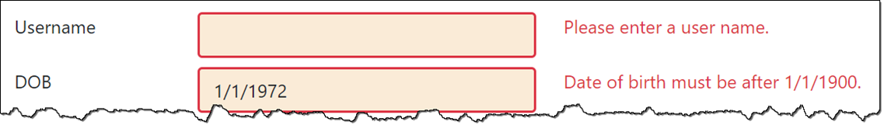
The form in the browser with client-side validation

Slide 32
Classes used to create a custom attribute
ValidationAttribute
ValidationContext
ValidationResult
A virtual method of the ValidationAttribute class
IsValid(object?, context)
A constructor of the ValidationResult class
ValidationResult(string)
A field of the ValidationResult class
Success

Slide 33
A custom data attribute that checks if a date is in the past
using System.ComponentModel.DataAnnotations;
...
public class PastDateAttribute : ValidationAttribute
{
protected override ValidationResult IsValid(object? value,
ValidationContext ctx)
{
if (value is DateTime) {
DateTime dateToCheck = (DateTime)value;
if (dateToCheck < DateTime.Today) {
return ValidationResult.Success!;
}
}
string msg = base.ErrorMessage ??
$"{ctx.DisplayName} must be a valid past date.";
return new ValidationResult(msg);
}
}

Slide 34
Code that uses the PastDate attribute with the default validation message
[PastDate]
public DateTime? DOB { get; set; }
How it looks in the browser
Code that uses the PastDate attribute with a custom validation message
[PastDate(ErrorMessage =
"Please enter a date of birth in the past.")]
public DateTime? DOB { get; set; }

Slide 35
A custom attribute that accepts values (part 1)
public class YearsFromNowAttribute : ValidationAttribute
{
private int numYears;
public YearsFromNowAttribute(int years) {
numYears = years;
}
public bool IsPast { get; set; } = false;
protected override ValidationResult IsValid(object? value,
ValidationContext ctx)
{
if (value is DateTime) {
// cast value to DateTime
DateTime dateToCheck = (DateTime)value;
// calculate date range
DateTime now = DateTime.Today;
DateTime limit;
if (IsPast) {
limit = new DateTime(now.Year, 1, 1);
limit = limit.AddYears(-numYears);
}

Slide 36
A custom attribute that accepts values (part 2)
else {
limit = new DateTime(now.Year, 12, 31);
limit = limit.AddYears(numYears);
}
// check date
if (IsPast) {
if (dateToCheck >= limit && dateToCheck < now) {
return ValidationResult.Success!;
}
}
else {
if (dateToCheck > now && dateToCheck <= limit) {
return ValidationResult.Success!;
}
}
}
string msg = base.ErrorMessage ??
ctx.DisplayName + " must be a " +
(IsPast ? "past" : "future") + " date within " +
numYears + " years of now.";
return new ValidationResult(msg);
}
}

Slide 37
A DOB property that requires a past date no more than 100 years ago
[YearsFromNow(100, IsPast = true)]
public DateTime? DOB { get; set; }

Slide 38
A custom attribute that checks more than one property in a class
public class RequiredContactInfoAttribute : ValidationAttribute
{
protected override ValidationResult IsValid(object? v,
ValidationContext c){
var cust = (Customer)c.ObjectInstance;
if (string.IsNullOrEmpty(cust.PhoneNumber) &&
string.IsNullOrEmpty(cust.EmailAddress))
{
string msg = base.ErrorMessage ??
"Enter phone number or email.";
return new ValidationResult(msg);
}
else {
return ValidationResult.Success!;
}
}
}

Slide 39
The method of the IValidatableObject interface
Validate(context)
A constructor of the ValidationResult class
ValidationResult(string, list)

Slide 40
A custom validation class that checks more than one field
public class Customer : IValidatableObject {
...
[Required(ErrorMessage = "Please enter a date of birth.")]
public DateTime? DOB { get; set; }
public string? PhoneNumber { get; set; }
public string? EmailAddress { get; set; }
public IEnumerable<ValidationResult> Validate(ValidationContext ctx) {
if (DOB > DateTime.Now)
{
yield return new ValidationResult(
"Date of birth can't be in the future.",
new[] { nameof(DOB) });
}
if (string.IsNullOrEmpty(PhoneNumber) &&
string.IsNullOrEmpty(EmailAddress))
{
yield return new ValidationResult(
"Please enter a phone number or email address.",
new[] { nameof(PhoneNumber), nameof(EmailAddress) });
}
}
}

Slide 41
A method of the IClientModelValidator interface
AddValidation(context)

Slide 42
The updated PastDate attribute with client-side validation (part 1)
using Microsoft.AspNetCore.Mvc.ModelBinding.Validation;
...
public class PastDateAttribute : ValidationAttribute, IClientModelValidator
{
private int numYears;
public PastDateAttribute(int years = -1) => numYears = years;
protected override ValidationResult IsValid(object? value,
ValidationContext ctx)
{
if (value is DateTime) {
DateTime dateToCheck = (DateTime)value;
if (numYears == -1) { // no limit on past date
if (dateToCheck < DateTime.Today)
return ValidationResult.Success!;
} else {
DateTime minDate = DateTime.Today.AddYears(-numYears);
if (dateToCheck >= minDate && dateToCheck < DateTime.Today)
return ValidationResult.Success!;
}
}
return new ValidationResult(GetMsg(ctx.DisplayName ?? "Value"));
}

Slide 43
The updated PastDate attribute with client-side validation (part 2)
public void AddValidation(ClientModelValidationContext c)
{
if (!c.Attributes.ContainsKey("data-val"))
c.Attributes.Add("data-val", "true");
c.Attributes.Add("data-val-pastdate-numyears", numYears.ToString());
c.Attributes.Add("data-val-pastdate", GetMsg(
c.ModelMetadata.DisplayName ?? c.ModelMetadata.Name ?? "Value"));
}
private string GetMsg(string name) =>
base.ErrorMessage ?? name + " must be a valid past date" +
(numYears == -1 ? "." : " (max " + numYears + " years ago).");
}

Slide 44
A model property with the PastDate attribute
[PastDate(100)]
public DateTime? DOB { get; set; }
The HTML that the PastDate attribute emits
<input type="text" class="form-control" data-val="true"
data-val-pastdate=
"DOB must be a valid past date (max 100 years ago)."
data-val-pastdate-numyears="100" id="DOB" name="DOB" value="" />

Slide 45
The pastdate.js file (part 1)
jQuery.validator.addMethod("pastdate",
function (value, element, param) {
// get date entered by user, confirm it's a date
if (value === '') return false;
var dateToCheck = new Date(value);
if (dateToCheck === "Invalid Date") return false;
// get number of years
var numYears = Number(param);
// get current date
var now = new Date();

Slide 46
The pastdate.js file (part 2)
// check date
if (numYears == -1) {
if (dateToCheck < now) return true;
} else {
// calculate limit
var minDate = new Date();
var minYear = now.getFullYear() - numYears;
minDate.setFullYear(minYear);
if (dateToCheck >= minDate && dateToCheck < now)
return true;
}
return false;
});
jQuery.validator.unobtrusive.adapters.addSingleVal(
"pastdate", "numyears");

Slide 47
The header section of the layout
<head>
<meta name="viewport" content="width=device-width" />
<link href="~/lib/bootstrap/dist/css/bootstrap.min.css"
rel="stylesheet" />
<script src="~/lib/jquery/jquery.min.js"></script>
<script src="~/lib/jquery-validation/jquery.validate.min.js">
</script>
<script src="~/lib/jquery-validation-unobtrusive/
jquery.validate.unobtrusive.min.js"></script>
<script src="~/js/pastdate.js"></script>
<title>@ViewBag.Title</title>
</head>

Slide 48
Two constructors of the RemoteAttribute class
RemoteAttribute(act, ctl)
RemoteAttribute(act, ctl, area)
A model property with a Remote attribute
using Microsoft.AspNetCore.Mvc;
...
[Remote("CheckEmail", "Validation")]
public string Email { get; set; } = string.Empty;
The CheckEmail() action method
public JsonResult CheckEmail(string email) {
bool hasEmail = DB.CheckEmail(email); // checks database
if (hasEmail)
return Json(
$"Email address {email} is already registered.");
else
return Json(true);
}

Slide 49
One property of the RemoteAttribute class
AdditionalFields
Remote validation that gets data from additional fields
The model
[Remote("CheckEmail", "Validation",
AdditionalFields = "Username, Region")]
public string Email { get; set; } = string.Empty;
public string Username { get; set; } = string.Empty;
The view
<input asp-for="EmailAddress" class="form-control" />
<input asp-for="Username" class="form-control" />
<input type="hidden" name="Region" value="West" />
The CheckEmail() action method
public JsonResult CheckEmail (string email, string username, string region){
// validation code
}

Slide 50
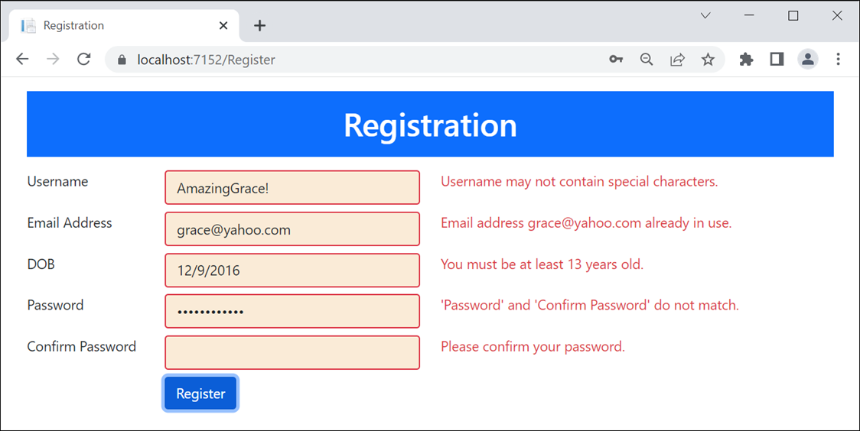
The Registration app with invalid data

Slide 51
The CSS for the validation class
.input-validation-error {
border: 2px solid #dc3545; /* text-danger */
background-color: #faebd7; /* antique white */
}

Slide 52
The Customer class (part 1)
using System.ComponentModel.DataAnnotations;
using System.ComponentModel.DataAnnotations.Schema;
using Microsoft.AspNetCore.Mvc;
...
public class Customer
{
public int ID { get; set; } // automatically generated
[Required(ErrorMessage = "Please enter a username.")]
[RegularExpression("^[a-zA-Z0-9 ]+$", ErrorMessage = "Username may not contain special characters.")]
public string Username { get; set; } = string.Empty;
[Required(ErrorMessage = "Please enter an email address.")]
[Remote("CheckEmail", "Validation")]
[Display(Name = "Email Address")]
public string EmailAddress { get; set; } = string.Empty;
[Required(ErrorMessage = "Please enter a date of birth.")]
[MinimumAge(13, ErrorMessage =
"You must be at least 13 years old.")]
public DateTime? DOB { get; set; }

Slide 53
The Customer class (part 2)
[Required(ErrorMessage = "Please enter a password.")]
[Compare("ConfirmPassword")]
[StringLength(25, ErrorMessage = "Please limit your password to 25 characters.")]
public string Password { get; set; } = string.Empty;
[Required(ErrorMessage = "Please confirm your password.")]
[Display(Name = "Confirm Password")]
[NotMapped]
public string ConfirmPassword { get; set; } = string.Empty;
}

Slide 54
The RegistrationContext class
public class RegistrationContext : DbContext
{
public RegistrationContext(
DbContextOptions<RegistrationContext> options)
: base(options) { }
public DbSet<Customer> Customers { get; set; } = null!;
}

Slide 55
The MinimumAgeAttribute class (part 1)
using System.ComponentModel.DataAnnotations;
using Microsoft.AspNetCore.Mvc.ModelBinding.Validation;
...
public class MinimumAgeAttribute : ValidationAttribute, IClientModelValidator
{
private int minYears;
public MinimumAgeAttribute(int years) {
minYears = years;
}
// overrides IsValid() method of ValidationAttribute base class
protected override ValidationResult IsValid(object? value,
ValidationContext ctx) {
if (value is DateTime) {
DateTime dateToCheck = (DateTime)value;
dateToCheck = dateToCheck.AddYears(minYears);
if (dateToCheck <= DateTime.Today) {
return ValidationResult.Success!;
}
}
return new ValidationResult(
GetMsg(ctx.DisplayName ?? "Date"));
}

Slide 56
The MinimumAgeAttribute class (part 2)
// implements AddValidation() method of IClientModelValidator
// interface
public void AddValidation(ClientModelValidationContext ctx) {
if (!ctx.Attributes.ContainsKey("data-val"))
ctx.Attributes.Add("data-val", "true");
ctx.Attributes.Add("data-val-minimumage-years",
minYears.ToString());
ctx.Attributes.Add("data-val-minimumage",
GetMsg(ctx.ModelMetadata.DisplayName ??
ctx.ModelMetadata.Name ?? "Date"));
}
private string GetMsg(string name) =>
base.ErrorMessage ??
$"{name} must be at least {minYears} years ago.";
}

Slide 57
The minumim-age JavaScript file
jQuery.validator.addMethod("minimumage",
function(value, element, param) {
if (value === '') return false;
var dateToCheck = new Date(value);
if (dateToCheck === "Invalid Date") return false;
var minYears = Number(param);
dateToCheck.setFullYear(dateToCheck.getFullYear() +
minYears);
var today = new Date();
return (dateToCheck <= today);
});
jQuery.validator.unobtrusive.adapters.addSingleVal(
"minimumage", "years");

Slide 58
The Validation controller
public class ValidationController : Controller
{
private RegistrationContext context;
public RegisterController(RegistrationContext ctx) =>
context = ctx;
public JsonResult CheckEmail(string emailAddress)
{
string msg = Check.EmailExists(context,
emailAddress);
if (string.IsNullOrEmpty(msg)) {
TempData["okEmail"] = true;
return Json(true);
}
else return Json(msg);
}
}

Slide 59
The Register controller (part 1)
public class RegisterController : Controller
{
private RegistrationContext context;
public RegisterController(RegistrationContext ctx) =>
context = ctx;
public IActionResult Index() => View();
[HttpPost]
public IActionResult Index(Customer customer)
{
if (TempData["okEmail"] == null) {
string msg = Check.EmailExists(context,
customer.EmailAddress);
if (!String.IsNullOrEmpty(msg)) {
ModelState.AddModelError(
nameof(Customer.EmailAddress), msg);
}
}

Slide 60
The Register controller (part 2)
if (ModelState.IsValid) {
context.Customers.Add(customer);
context.SaveChanges();
return RedirectToAction("Welcome");
}
else return View(customer);
}
}

Slide 61
The static Check class
public static class Check
{
public static string EmailExists(RegistrationContext ctx,
string email) {
string msg = string.Empty;
if (!string.IsNullOrEmpty(email)) {
var customer = ctx.Customers.FirstOrDefault(
c => c.EmailAddress.ToLower() == email.ToLower());
if (customer != null)
msg = $"Email address {email} already in use.";
}
return msg;
}
}

Slide 62
The layout
<!DOCTYPE html>
<html>
<head>
<meta name="viewport" content="width=device-width,
initial-scale=1.0" />
<title>@ViewData["Title"]</title>
<link rel="stylesheet" type="text/css"
href="~/lib/bootstrap/dist/css/bootstrap.min.css">
<link rel="stylesheet" href="~/css/site.css" />
</head>
<body>
<div class="container">
<header class="bg-primary text-white text-center">
<h1 class="m-3 p-3">Registration</h1>
</header>
<main>
@RenderBody()
</main>
</div>
<script src="~/lib/jquery/dist/jquery.min.js"></script>
@RenderSection("scripts", required: false)
</body>
</html>

Slide 63
The Register/Index view (part 1)
@model Customer
@{
ViewData["Title"] = "Registration";
}
@section scripts {
<script src="~/lib/jquery-validation/dist/jquery.validate.min.js">
</script>
<script src="~/lib/jquery-validation-unobtrusive/
jquery.validate.unobtrusive.min.js"></script>
<script src="~/js/minimum-age.js"></script>
}
<form asp-action="Index" method="post">
<div class="row mb-2">
<div class="col-md-2">
<label asp-for="Username" class="form-label"></label>
</div>
<div class="col-md-4">
<input asp-for="Username" class="form-control" />
</div>

Slide 64
The Register/Index view (part 2)
<div class="col">
<span asp-validation-for="Username" class="text-danger">
</span>
</div>
</div>
<!-- Email address field not shown -->
<div class="row mb-2">
<div class="col-md-2">
<label asp-for="DOB" class="form-label"></label>
</div>
<div class="col-md-4">
<input asp-for="DOB" class="form-control" type="text" />
</div>
<div class="col">
<span asp-validation-for="DOB" class="text-danger">
</span>
</div>
</div>
<div class="row mb-2">
<div class="col-md-2">
<label asp-for="Password" class="form-label"></label>
</div>

Slide 65
The Register/Index view (part 3)
<div class="col-md-4">
<input asp-for="Password" class="form-control"
type="password" />
</div>
<div class="col">
<span asp-validation-for="Password" class="text-danger">
</span>
</div>
</div>
<!-- ConfirmPassword field not shown -->
<div class="row">
<div class="offset-md-2 col">
<button type="submit" class="btn btn-primary">
Register</button>
</div>
</div>
</form>

